Slide 1
Software Architecture
Documenting software architecture in practice Exercise 3

Slide 2
Intended Learning Outcomes
By the end of this lesson you will be able to:
Create a documentation for a real system

Slide 3
Review

Slide 4
Structures and Views
Architecture Is a Set of Software Structures
A structure is the set of elements itself, as they exist in software or hardware.
In short, a view is a representation of a structure.
Architects design structures. They document views of those structures.

Slide 5
Architecture Documentation
Even the best architecture will be useless if the people who need it
do not know what it is;
cannot understand it well enough to use, build, or modify it;
misunderstand it and apply it incorrectly.
All of the effort, analysis, hard work, and insightful design on the part of the architecture team will have been wasted.

Slide 6
Architecture Documentation and Stakeholders
Education
Introducing people to the system
New members of the team
External analysts or evaluators
New architect
Primary vehicle for communication among stakeholders
Especially architect to developers
Especially architect to future architect!
Basis for system analysis and construction
Architecture tells implementers what to implement.
Each module has interfaces that must be provided and uses interfaces from other modules.
Documentation can serve as a receptacle for registering and communicating unresolved issues.
Architecture documentation serves as the basis for architecture evaluation.

Slide 7
Views
Principle of architecture documentation:
Documenting an architecture is a matter of documenting the relevant views and then adding documentation that applies to more than one view.

Slide 8
Which Views? The Ones You Need!
Different views support different goals and uses.
The views you should document depend on the uses you expect to make of the documentation.
Each view has a cost and a benefit; you should ensure that the benefits of maintaining a view outweigh its costs.

Slide 9
Building the Documentation Package
Documentation package consists of
Views
Documentation beyond views

Slide 10
View Template

Slide 12
Implementation and deployment views

Slide 13
Implementation View
Describes the static organization of the software in its development environment.
Viewer
Programmers and Software Managers
Considers
Software module organization - Hierarchy of layers, software management, reuse, constraints of tools
Style
layered style

Slide 14
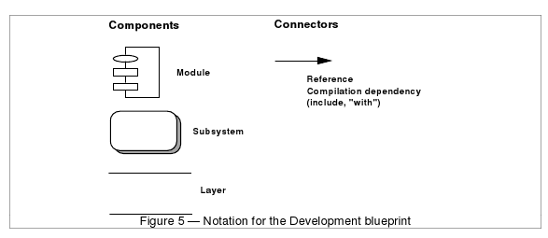
Notation

Slide 15
Activity
For our simple ATM network, with additional database servers deployed, create an implementation view

Slide 16

主观题
10分
For our simple ATM network, with additional database servers deployed, create an implementation view
Open Question is only supported on Version 2.0 or newer.
Answer

Slide 17
Implementation and deployment views
Implementation view

Slide 18
Deployment View
Describes the mapping(s) of the software onto the hardware and reflects its distributed aspect.
Viewer
System Engineers
Considers
Non-functional requirement (reliability, availability and performance) regarding to underlying hardware.

Slide 19
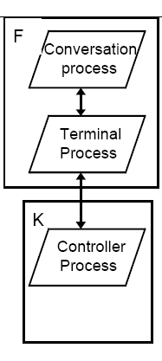
Deployment view example

Slide 20
Activity
For our simple ATM network, with additional database servers deployed, create a deployment view

Slide 21
主观题
10分
For our simple ATM network, with additional database servers deployed, create a deployment view
Open Question is only supported on Version 2.0 or newer.
Answer

Slide 22
Implementation and deployment views
Implementation view
Deployment view

Slide 24
Use Case View
Captures system functionality as seen by users
Built in early stages of development
Developed by analysts and domain experts
System behavior, that is what functionality it must provide, is documented in a use case model.

Slide 25
Use Case Model
Illustrates the system’s intended functions (use cases), its surroundings (actors), and relationships between the use cases and actors (use case diagrams).
provides a vehicle used by the customers or end users and the developers to discuss the system’s functionality and behavior.
starts in the Inception phase with the identification of actors and principal use cases for the system, and is then matured in the elaboration phase, by adding more details and additional use cases.

Slide 26
Graphical Constructs
Actors
represent anyone or anything that must interact with the system: they are not part of the system.
may:
only input information to the system
only receive information from the system
input and receive information to and from the system
In the UML, an actor is represented as a stickman with a name

Slide 27
Use Cases
represent the functionality provided by the system; that is:
what capabilities will be provided to an actor by the system or
what tasks are performed by each actor?
sequence of transactions performed by a system that yields a measurable result of values for a particular actor.
In the UML, a use case is represented by an oval with a name inside:

Slide 28
Use Case Relationships
Association:
a relationship that represents communication between an actor and a use case;
can be navigable in both ways or in only one way.
Inheritance:
Generalization or specialization relationships that may exist between actors.
Two types of relationships that may exist between use cases: uses and extends:
A functionality shared by multiple use cases can be placed in a separate use case which is related to these uses cases by a uses relationship.
An extends relationship is used to show:
Optional behaviour
Behaviour that is only run under certain conditions, such as triggering an alarm
Different flows which may be run based on actor selection

Slide 29
Use Case Diagrams
A graphical view of the actors, use cases, and their interactions identified for a system.
Consists of the system boundary, and the graphical description of the actors, use cases, and their relationships.

Slide 30
Use Case Diagram Example: (Embedded) Cellular Telephone System

Slide 31
Activity
Provide the use case diagram for the architecture of an ATM System

Slide 32
主观题
10分
Provide the use case diagram for the architecture of an ATM System
Open Question is only supported on Version 2.0 or newer.
Answer

Slide 35
Sequence Diagram Example

Slide 36
Activity
Expand your Use Case with a sequence diagram to document a basic sequence of actions during transactions

Slide 37
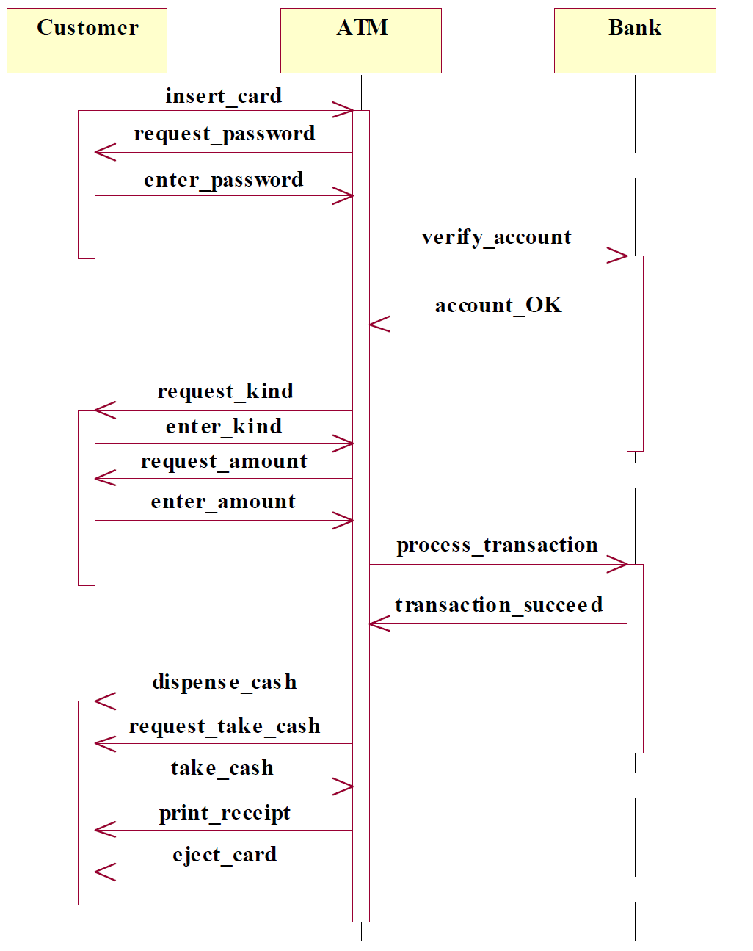
Activity
Expand your Use Case with a sequence diagram to document a basic sequence of actions during transactions

Slide 38
主观题
10分
Submit your answer here
Open Question is only supported on Version 2.0 or newer.
Answer

Slide 39
Textual Description of a Use Case
Each use case is documented with a flow of events, which is a description of the events needed to accomplish the required behavior.
The flow of events is written in the language of the domain and describe what the system should do and not how the system does it.
The flow of events should include:
When and how the use case starts and ends
What interaction the use case has with the actors
What data is needed by the use case
The normal sequence of events for the use case
The description of any alternate or exceptional flows

Slide 40
Textual Description of a Use Case

Slide 41
Use Case Diagram Example 2

Slide 42
Use Case Description Example

Slide 43
Activity
Provide the textual description for Check PIN Use Case of our ATM
ATM System Requirements:
The Interbank Consortium, a hypothetical financial institution, has directed its software development subsidiary, Interbank Software, to develop new services that support a network of automated teller machines (ATMs).
Customers use ATMs to make queries, withdrawals, deposits and funds transfers involving their accounts. Thieves or crooks must be prevented from interfering with these actions.
Interactions with the ATM would work like this:
The customer inserts his/her bank card into the ATM.
The ATM prompts the customer for a "password" which the user enters at the ATM.
The customer then selects an action to be performed; the selected action is then performed by the branch (perhaps causing dispersal of cash at the ATM).
Additionally, the bank would like to be able to use the system to maintain statistics about customers’ behaviour in order to adapt its services to their needs, and also to send them some advertisements when they are using the system.

Slide 46
Discussion
Relating Structures to Each Other
Elements of one structure will be related to elements of other structures, and we need to reason about these relations.
A module in a decomposition structure may be manifested as one, part of one, or several components in one of the component-and-connector structures.
In general, mappings between structures are many to many.
Not all architectures need all views.
Architecture documents need to address the concerns of all stakeholders
end-user
system engineers
developers
project managers
Use different notations for several views each one addressing one specific set for concerns.

Slide 47
Homework 3
Develop 2 more views for our ATM system.
For each view describe who and when will need to use this view.
Submission:
Deadline: April 21st
Place: submit to Blackboard

